Slide 1
AWS BUDGETS AND BILLS
PREsented by:-
Muddapolu tejaswini
Sowmya raji
sharmila

Slide 2
AWS BUDGET
You can use AWS Budgets to track and take action on your AWS costs and usage.
You can create the following types of budgets:
Cost budgets – Plan how much you want to spend on a service.
Usage budgets – Plan how much you want to use one or more services.
RI utilization budgets – Define a utilization threshold and receive alerts when your RI usage falls below that threshold. This lets you see if your RIs are unused or under-utilized.
RI coverage budgets – Define a coverage threshold and receive alerts when the number of your instance hours that are covered by RIs fall below that threshold. This lets you see how much of your instance usage is covered by a reservation.

Slide 3
BUDGET AND ALERT
Go to the AWS Management Console and select Billing.
Click Budgets.
Click Create Budget.
Enter a name for your budget and select a currency.
Select a spending threshold and frequency.
Click Create Budget.
Once your budget is created, you can create an alarm. Click Alerts and then Create Alerts.
Select your budget from the list and enter a threshold value.
Select an action to take when your budget is exceeded.
Click Create Alerts.

Slide 4
BUDGET REPORT
To create an AWS Budgets report
Sign in to the AWS Management Console and open the AWS Billing console at https://console.aws.amazon.com/billing/.
In the navigation pane, choose Budgets Reports.
On the top right of the page, choose Create budget report.
For Report frequency, choose Daily, Weekly, or Monthly.
If you choose a Weekly report: For Day of week, choose the day of the week that you want the report delivered.
For Email recipients, enter the email addresses to deliver the report to. Separate multiple email addresses with commas. You can include up to 50 email recipients for each budget report.
For Budget report name, enter the name of your budget report. This name appears on the subject line of the budget report email. You can change the report name at any time.
Choose Create budget report.

Slide 5
AWS BILLING
The AWS Billing console contains features to pay your AWS bills and report your AWS cost and usage.
With the features in AWS Billing console, you can do the following tasks:
Manage your account: Manage your account settings using the AWS Management Console and Billing console. This includes designating your default currency, editing alternate contacts, adding or removing AWS Regions, updating your tax information, and closing your AWS account. The close your account highlights considerations before you close your AWS account. For example, terminating resources before you close the account so you aren't charged for unused services.
View your bill: You can use the AWS Billing console to view your past bill details or your estimated charges for your current month at any time. This section outlines how you can view your bills, download PDF copies of your charges, and set up monthly emails to receive your invoices. It also covers how you can use other resources such as AWS Cost and Usage Reports.

Slide 6
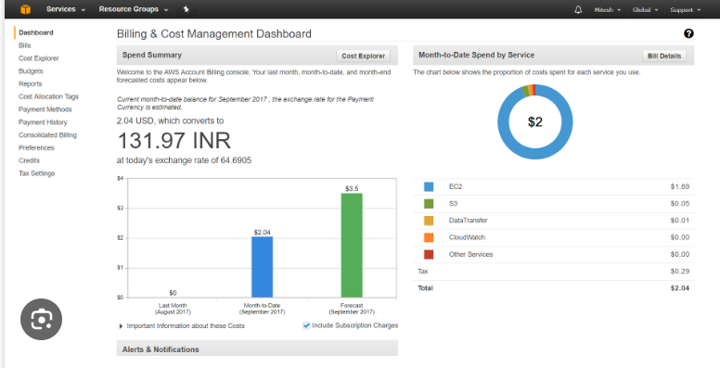

Slide 7
COST EXPLORER
AWS Cost Explorer is a tool that enables you to view and analyze your costs and usage.
You can view data for up to the last 12 months, forecast how much you're likely to spend for the next 12 months, and get recommendations for what Reserved Instances to purchase.
You can use Cost Explorer to identify areas that need further inquiry and see trends that you can use to understand your costs.
You can view your costs and usage using the Cost Explorer user interface free of charge.
You can't disable Cost Explorer after you enable it.
In addition, Cost Explorer provides preconfigured views that display at-a-glance information about your cost trends and give you a head start on customizing views that suit your needs.

Slide 8

Have an AWSome Day

